Slide 1
NIST Information Technology Laboratory Video Analytics Research
Video Quality Experts Group meeting
Madrid, Spain
March 19-23, 2018

Slide 2
Video Quality Metrics for Public Safety
Public Safety has substantial needs in video analytics
Video Analytics plays an important role in the future public safety video ecosystem by leveraging a quantitative understanding of video content
Ability to move video efficiently to avoid bandwidth and storage issues
Tools and techniques for efficiently redacting video
Minimum acceptable video quality to perform certain public safety tasks, including an understanding of how video transmitted across both wired and wireless networks affects quality (e.g., bandwidth limits)

Slide 3
Video Analytics State of the Art
Major challenges
Motion blur, focus, color accuracy
Resolution on key scene content (e.g., objects, people)
Illumination/lighting
Occlusions/scene and motion complexity
Semantic interpretation
Assumption
Quality related to both clarity and content significant impacts video analytics performance

Slide 4
Video Quality Metrics
Quality impacts automated and manual video workflow processes at all levels
Upstream quality issues multiply downstream processing issues
Capture
Encoding
Compression
Transmission/ Communications
Broadcasting/ Distribution
Alerting
Triage
Forensics
Data Storage and Management

Slide 5
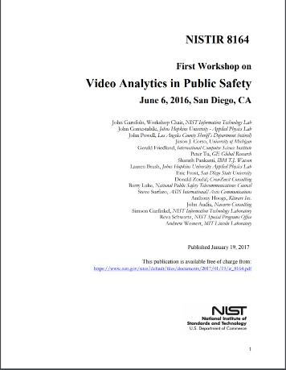
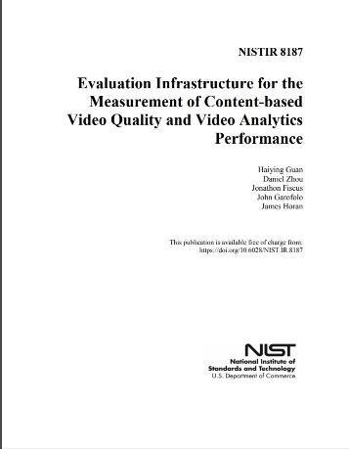

Slide 6
Video Quality Metrics (VQM): Survey
NGA: NIIRS & VNIIRS
Subjective quality assessment
Based on human interpretation
National Imagery Interpretability Rating Scale(NIIRS)
Video-National Imagery Interpretability Rating Scale (VNIIRS)
NTIA & ITU: VQM
National Telecommunications & Information Administration (NTIA)
International Telecommunication Union (ITU)
Over 20 years
Academia
Full reference, Reduced reference, and No-reference
Still in research stage
Video BLLINDS: Univ. of Texas

Slide 7
Video Quality Metrics (VQM): State of the Art
Existing quality metrics are not suitable for video analytics
Most existing quality metrics are optimized for subjective human visual perception instead of visual analysis.
Most existing quality metrics measure signal-level information loss rather than semantic content loss.
The requirements for video quality measurement related to manual and automated analytics likely differ.
No video quality metrics have been identified in the literature that are designed to predict the use of video in manual or automated video analysis.
There are currently significant quantitative unknowns in understanding the effective collection and use of video for surveillance or forensic applications.
Future content-based video quality metrics designed for video analytics and suitable for public safety applications will:
help optimize the placement and use of video cameras
ground forensic video data and equipment standards
improve optimization of compression for public safety video analysis applications
improve the performance of both human and automated video analysis systems

Slide 8
Summary
Contributions
Developed approach to foster future joint VQM and VA R&D
Developed suggested requirements for future datasets to support both quality and analytic analysis
Developed tool set to support measurement of VQM tools with regard to video analytics performance
Built infrastructure necessary to support future research in this area
This is a need area for investment to create critical mass in R&D
R&D programs combined with open evaluation frameworks have been successful in fostering the acceleration of similar analytic technologies and measurement standards.
Reference data development must precede the funding of such R&D.

Slide 9
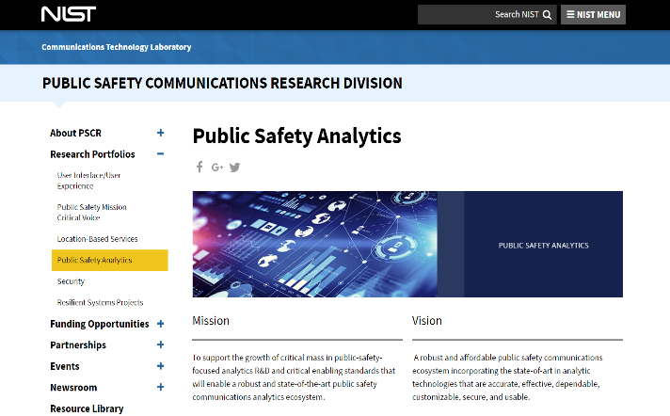
https://www.nist.gov/ctl/pscr/research-portfolios/public-safety-analytics

Slide 10
Thank You!

